Slide 1
Design and Analysis of Algorithms
Algorithms-II : CS345A
Lecture 11
Shortest paths in graphs with positive weights

Slide 2
Recap of last lecture

Slide 3

Problem Definition
Input: A directed graph $G=(V,E)$ with $ω:E→R^{+}$ and a source vertex $s∈V$
Aim:
Compute $δ(s,v)$ for all $v∈V\backslash \{s\}$
Compute $P(s,v)$ for all $v∈V\backslash \{s\}$

Slide 4


An example to get an insight into this problem
$$q$$
5
7
6
12
G
$$s$$
16
4
9
11

Slide 5






An example to get an insight into this problem
Let us look at the neighborhood of $s$
$$z$$
$$v$$
10
G
12
7
$$x$$
$$s$$
3
5
$$u$$
$$y$$

Slide 6




An example to get an insight into this problem
➔ The shortest path to vertex $u$ is edge ($s$,$u$).
$$z$$
$$v$$
10
G
12
7
$$x$$
$$s$$
3
5
$$u$$
$$y$$
$$>0$$
The nearest vertex of $s$ must be $s$’s neighbor.

Slide 7







Designing a greedy algorithm for shortest paths
What should be the greedy step such that
“we can retrieve distance from $s$in $G$ using distance from $s$in $G′$ ” ?
Opt($G$)
$$G$$
instance of size $n$
Greedy
step
?
Opt($G′$)
$$G′$$
instance of size $<n$

Slide 8
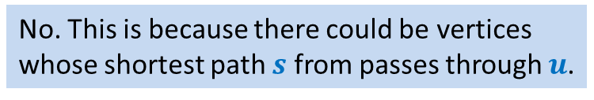
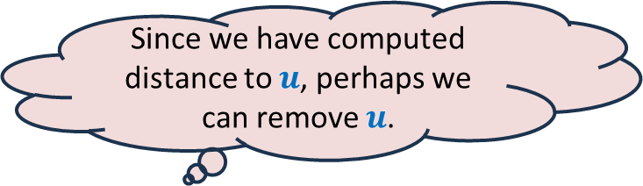



An example to get an insight into this problem
We know the distance to $u$.
Question: Can you remove vertex $u$ without affecting the distance from $s$ ?
$$z$$
$$v$$
10
G
12
7
2
$$x$$
$$s$$
21
$$t$$
3
5
$$u$$
3
8
$$y$$
$$r$$
Since we have computed distance to $u$, perhaps we can remove $u$.
No. This is because there could be vertices
whose shortest path $s$ from passes through $u$.

Slide 9

An example to get an insight into this problem
$$z$$
$$v$$
10
12
7
+3
G’
2
+3
$$x$$
21
$$t$$
$$s$$
5
+3
+3
8
3
$$y$$
$$r$$

Slide 10

An example to get an insight into this problem
Theorem: For each $v∈V\backslash \{s,u\}$,
$$δ_{G}\left(s,v\right)=δ_{G^{′}}\left(s,v\right)$$
$$z$$
$$v$$
10
G’
12
7
5
$$x$$
24
$$t$$
$$s$$
5
6
11
$$y$$
$$r$$

Slide 11
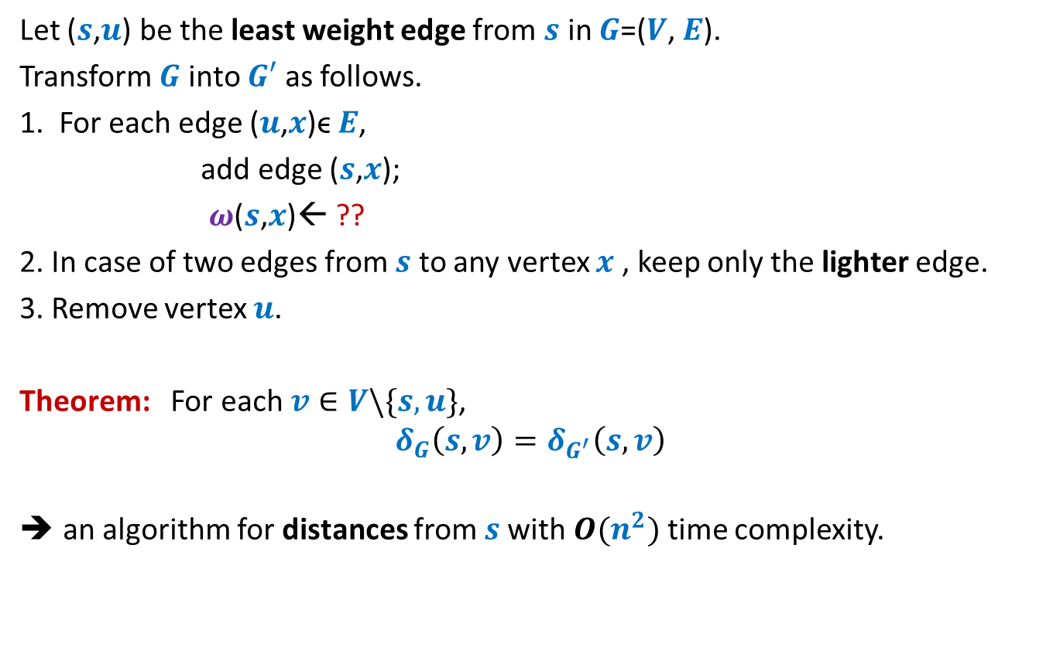


How to compute instance $G′$
Let ($s$,$u$) be the least weight edge from $s$ in $G$=($V$, $E$).
Transform $G$ into $G′$ as follows.
1. For each edge ($u$,$x$)ϵ $E$,
add edge ($s$,$x$);
$ω$($s$,$x$)← ??
2. In case of two edges from $s$ to any vertex $x$ , keep only the lighter edge.
3. Remove vertex $u$.
Theorem: For each $v∈V\backslash \{s,u\}$,
$$δ_{G}\left(s,v\right)=δ_{G^{′}}\left(s,v\right)$$
an algorithm for distances from $s$with $O(n^{2})$ time complexity.
$ω$($s$,$u$) + $ω$($u$,$x$);
Can you see some negative points of this algorithm ?

Slide 12
Shortcomings of the algorithm
No insight into the (beautiful) structure of shortest paths.
Just convinces that we can solve the shortest paths problem in polynomial time.
Very few options to improve the time complexity.
Silent about a compact data structure for storing all shortest paths from the source.
We shall now design a very insightful algorithm based on properties of shortest paths.

Slide 13
Properties of a shortest path

Slide 14






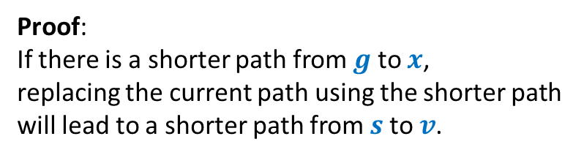


Optimal subpath property
Homework: Write a complete and formal proof for Lemma 1
Consider any shortest path $P(s,v)$.
$δ(s,v)$= 51
Lemma 1: Every subpath of a shortest path is also a shortest path.
Can you realize an assumption made by you in this proof ?
< 27
12
3
7
5
15
9
$$s$$
$$a$$
$$g$$
$$y$$
$$u$$
$$x$$
$v$
?
Proof:
If there is a shorter path from $g$ to $x$,
replacing the current path using the shorter path
will lead to a shorter path from $s$to $v$.

Slide 15




Exploiting the positive weight on edges
Consider once again a shortest path $P(s,v)$.
➔ $δ\left(s,a\right)<δ\left(s,g\right)<δ\left(s,y\right)<δ\left(s,u\right)<δ(s,x)<δ(s,v)$
This leads to an alternate proof to the following assertion ☺:
The nearest vertex of $s$ must be $s$’s neighbor.
$$>0$$
$$>0$$
$$>0$$
$$>0$$
$$>0$$
$$>0$$
$$s$$
$$a$$
$$g$$
$$y$$
$$u$$
$$x$$
$v$
(1)

Slide 16







More insights …
What can we say about $x$ ?
Let $s_{i}$ : $i$th nearest vertex from $s$.
$s_{0}$ = $s$.
Consider the shortest path $P\left(s,s_{i}\right)$.
Lemma 2: $P\left(s,s_{i}\right)$ must be of the form $s ⇝$ $s_{j} →s_{i}$ for some $j<i$.
$x$ must be $s_{j}$ for some $j<i$.
$$s$$
$$x$$
$s_{i}$
shortest
What picture captures all shortest paths from $s$?

Slide 17








Complete picture of all shortest paths ?
Shortest paths tree
$$s$$
$$s_{4}$$
$$s_{1}$$
$$s_{7}$$
$$s_{5}$$
$$s_{2}$$
$$s_{3}$$
$$s_{6}$$

Slide 18
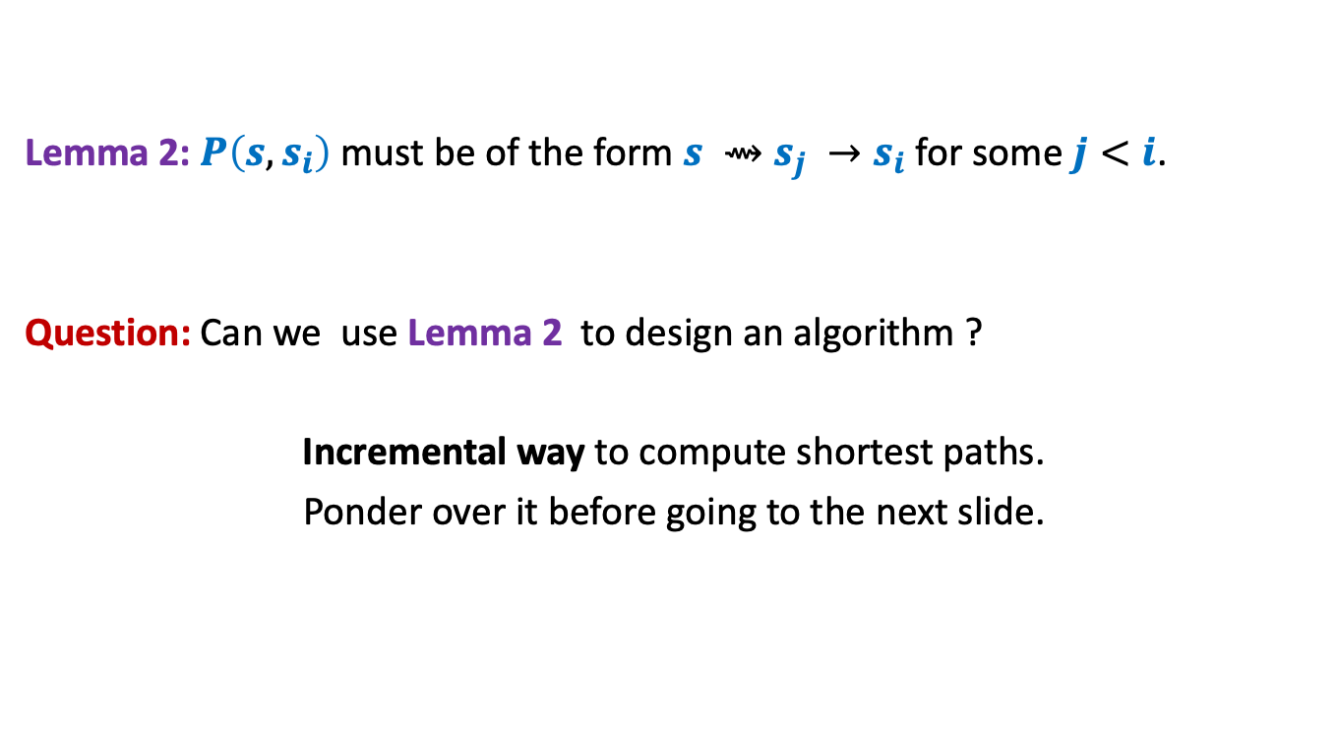
Designing the algorithm …
Lemma 2: $P\left(s,s_{i}\right)$ must be of the form $s ⇝$ $s_{j} →s_{i}$ for some $j<i$.
Question: Can we use Lemma 2 to design an algorithm ?
Incremental way to compute shortest paths.
Ponder over it before going to the next slide.
shortest

Slide 19



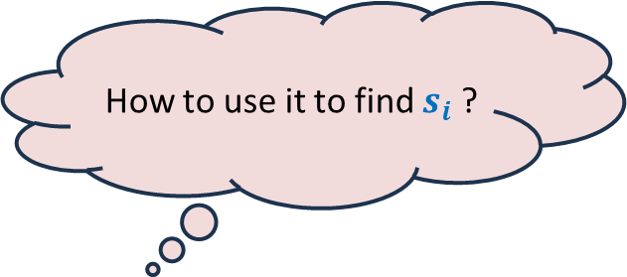

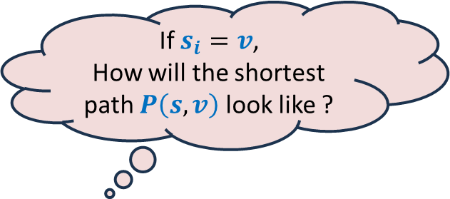
Suppose we have computed $s_{1}$, $s_{2}$,…, $s_{i−1}$.
How to find out $s_{i}$ ?
Using Lemma 2
Consider any $v∈V \backslash \{s_{1}\text{,} s_{2}\text{,…,} s_{i−1}\}$
Or
Or
$$s$$
G
$$s_{1}$$
$$s_{4}$$
$$v$$
$$s_{2}$$
$$s_{3}$$
If $s_{i}=v$,
How will the shortest path $P\left(s,v\right)$ look like ?
How to use it to find $s_{i}$ ?
Let us define a function $L\left(v\right)$
We need to just focus on
the edges incident on $v$ from $s_{1}$, $s_{2}$,…, $s_{i−1}$.
Isn’t it nice ☺ ?
Ponder over its usefulness before proceeding further.

Slide 20


Suppose we have computed $s_{1}$, $s_{2}$,…, $s_{i−1}$.
How to find out $s_{i}$ ?
For each $v∈V \backslash \{s_{1}\text{,} s_{2}\text{,…,} s_{i−1}\}$
$$L\left(v\right)=$$
$s_{i}$ is ??
Using Lemma 2
88
101
$$s$$
G
51
$$s_{1}$$
$$s_{4}$$
82
$$v$$
76
$$s_{2}$$
90
$$s_{3}$$
62
$$\left(δ\left(s,s_{j}\right)+ω\left(s_{j},v\right)\right)$$
$$\min_{\left({(s}_{j},v\right)∈E)}{ ? }$$
the vertex with minimum value of $L$.
How to find $s_{i}$ ?

Slide 21



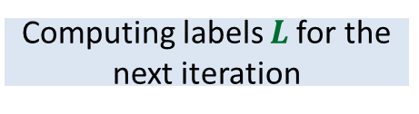
Dijkstra’s algorithm
Dijkstra-algo($s$,$G$)
$U$ ← $V$;
$L\left(s\right)$← $0$;
For $i$ = 0 to $n−1$ do
{ $y$← vertex from $U$ with minimum value of $L$;
$δ\left(s,y\right)\text{←}L\left(y\right)$;
move $y$ from $U$ to $S$;
For each $v∈U$ do
{ $L\left(v\right)$← $∞$;
For each $(x,v)∈E$ with $x∈S$do
$L\left(v\right) \text{←}$ min( $L\left(v\right)$, $δ\left(s,x\right)+ω\left(x,v\right)$ )
}
}
Only neighbors of $y$
$L\left(v\right)$← $∞$ for all $v∈U$ ;
Computing labels $L$for the next iteration
What are the vertices
whose $L$ value may change
in this iteration ?
a lot of re-computation

Slide 22

Dijkstra’s algorithm
Dijkstra-algo($s$,$G$)
$U$ ← $V$;
$L\left(s\right)$← $0$;
For $i$ = 0 to $n−1$ do
{ $y$← vertex from $U$ with minimum value of $L$;
$δ\left(s,y\right)\text{←}L\left(y\right)$;
move $y$ from $U$ to $S$;
For each $(y,v)∈E$ with $v∈U$do
{
$L\left(v\right) \text{←}$ min( $L\left(v\right)$, $δ\left(s,y\right)+ω\left(y,v\right)$ )
}
}
$L\left(v\right)$← $∞$ for all $v∈U$ ;
1 extract-min operation
deg($y$) Decrease-key operations

Slide 23
Homework
What data structure is to be used to efficiently implement the Dijkstra’s algorithm?
Write a neat pseudocode in terms of the data structure.
What is the time complexity of the implementation ?

